Slide 1
Object-Oriented Analysis and Design
Chapter 17: GRASP principles

Slide 2
What will we learn?
GRASP – Designing objects with responsibilities
We will enter the design phase: We’ll learn how to take the analysis we’ve done and convert it to an object-oriented design
Recall what we’ve done so far:
Explored Use Cases, and how to create
Explored how to create a Domain Model after the use cases were created
Explored how to create System Sequence Diagrams if necessary, and create Operations Contracts
On to the design …

Slide 3
Object Design: Principles
Several of the artifacts that were created during analysis stage (Inception, Elaboration phases) provide input into the design:
Use case text explain the behavior that software classes must ultimately support. This part of the design is called use case realization, because the design will ultimately “realize” the use cases
The SSDs describe the system event/operation messages (at a high level), and this is the starting point for our eventual interaction diagrams
We may have Operations Contracts that complement the use case text, to clarify that the software must achieve in a system operation
The Supplementary Specification captured any non-functional requirements
The Glossary would capture any requirements related to parameters or data, plus other details
The Domain Model suggests some names and attributes for our software objects, but at a high level

Slide 5
Object Design: How to Proceed
First step is usually a “modeling day”, where time is spent creating UML diagrams for the design model based upon the previously mentioned artifacts
The key idea is responsibility-driven design, which is essentially assigning responsibilities to collaborating objects
Will result in both static and dynamic diagrams, i.e. class and interaction diagrams
Small groups will work on various parts of the design, but shortly after (perhaps a one-day modeling workshop) the team will start coding
Remember, this is an iterative approach, not Waterfall!
Outputs include UML diagrams for object design (class diagrams), interaction diagrams, package diagrams, user interface sketches (and prototypes), database models, etc.

Slide 6
Responsibility Driven Design (RDD)
Basic idea is to assign responsibilities to the software objects
Two basic types of responsibility: Doing and Knowing
Doing: doing something, creating an object, doing a calculation, initiate some action in another object, control activity between objects. Generate some activity
Knowing: knowing about private encapsulated data, related objects, or things that can be derived or calculated
May also have Collaboration, in which an object may collaborate with several other objects to fulfill a responsibility
Note that responsibilities are not methods – they are an abstraction – but methods fulfill responsibilities
RDD leads to thinking of the system as a community of collaborating objects, each with a set of responsibilities

Slide 7
GRASP
GRASP = General Responsibility Assignment Software Patterns (or Principles)
GRASP names and describes basic principles to assign responsibilities – useful tool for RDD
Provides patterns for assigning responsibilities
What is a pattern?
A principle or idiom used that provide guidance in the creation of software
They have a name, describe a problem, and a solution to the problem
Patterns can be applied in various circumstances, to numerous contexts
Often these guide the assignment of responsibilities to objects
A good pattern is a named and well known problem/solution pair that can be applied in new contexts
Naming is important – provides a way to identify the pattern
Good patterns are usually the result of tried-and-true knowledge, i.e. solutions that have been applied many times before

Slide 8
Gang of Four
In 1994, four authors produced a book called Design Patterns
Gamma, Helm, Johnson, Vlissides
Described 23 patterns that are useful for OOD
Considered the “bible” of design pattern books
Often referred to as “Gang of Four” patterns, or GoF Patterns
We’ll see more in later chapters
We will call the GRASP ideas principles and the GoF ideas patterns
GRASP principles are more high level, general principles of object design
GoF patterns are more concrete, solutions to specific problems in object design

Slide 9
More on GRASP
GRASP defines 9 principles
These are basic building blocks in OOD
Creator
Controller
Information Expert
Low Coupling
High Cohesion
Polymorphism
Pure Fabrication
Indirection
Protected Variations

Slide 10
Creator
Problem: Who should be responsible for creating a new instance of some class?
Basic problem in design, so it’s a good idea to have a general principle for deciding how to solve this (i.e., how to assign this responsibility)
Solution: Assign class B the responsibility to create class A if one or more of the following is true:
B “contains” or completely aggregates A
B records A
B closely uses A
B has the initializing data for A that will be passed to A when it is created (B is an Expert with respect to creating A)
Example: Consider the Monopoly Game example. Who creates the Square object?

Slide 11
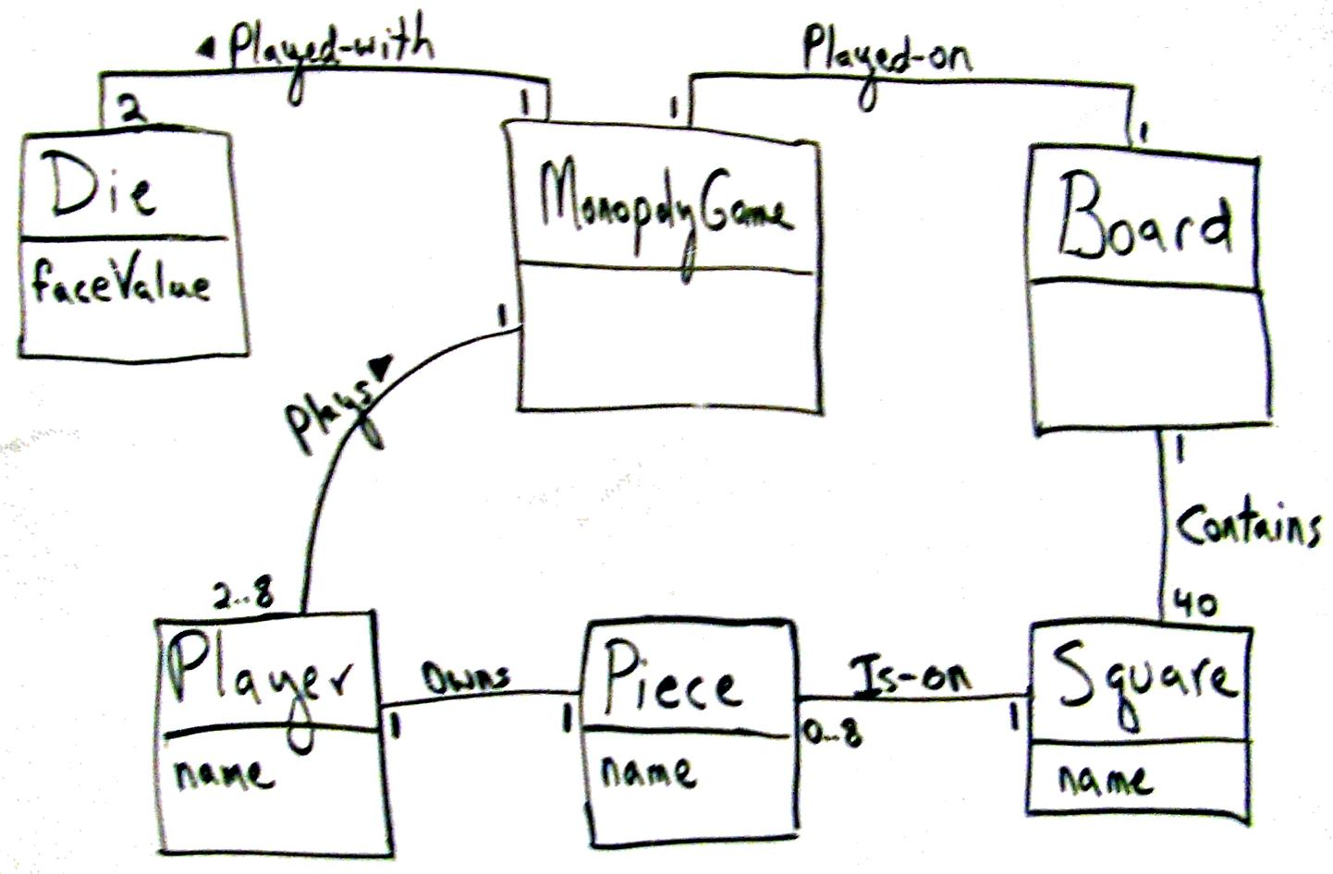

Slide 12
Creator
First, note that this is a Domain Model, not a class diagram – how do we get to the software classes?
Look to the Domain Model for inspiration on what the software objects should be
Notice that the Board conceptual class contains Squares – this suggests a software class composition
Board should create Squares, Squares are part of the Board, Board manages their creation and destruction (composition)
After reviewing the Domain Model diagram, we can conclude that a Board object would be a good creator for the Square object in our Design Model
Note we also include an interaction diagram, so we can create the dynamic object model along with the static object model

Slide 13
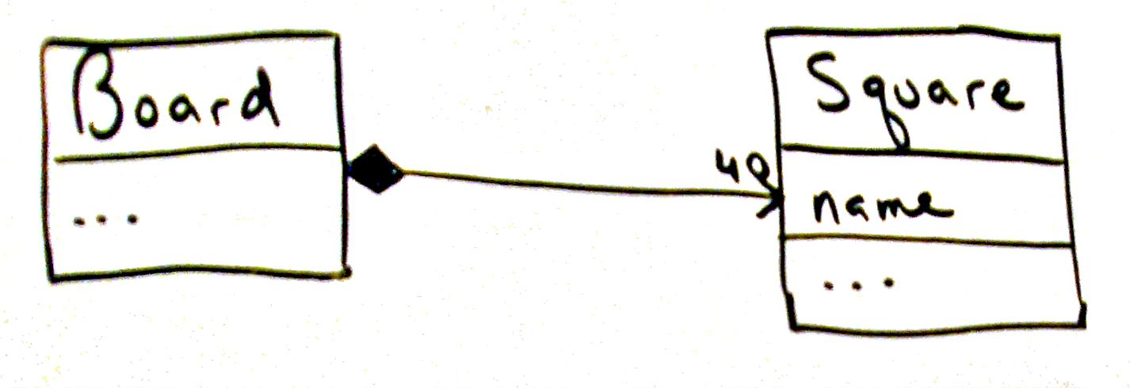
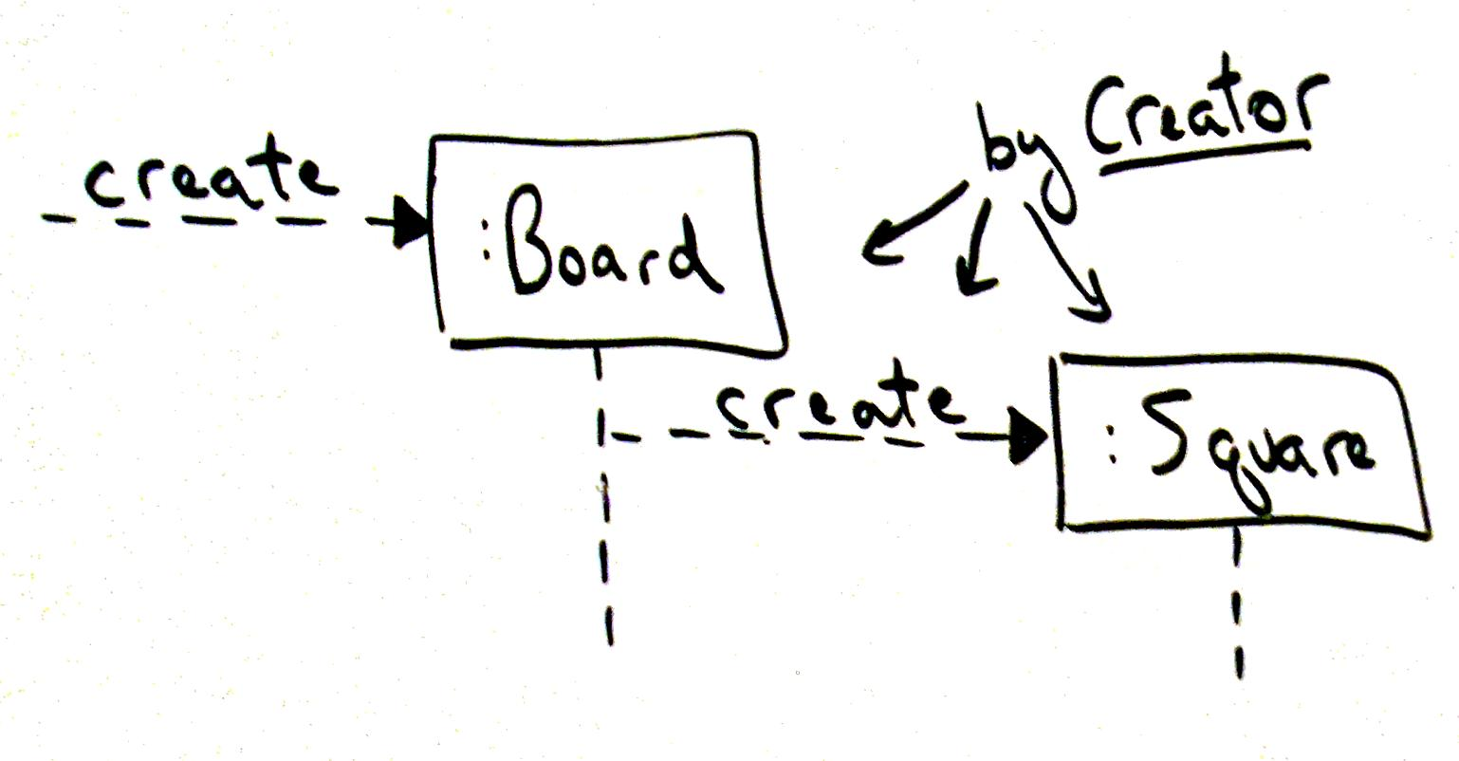

Slide 14
Dog Grooming Parlor
Recall that in our Dog Grooming example, we originally had the following in our domain model:
owns
1 … n
1
Dog
Customer

Slide 15
Dog Grooming Parlor
Since the dog is really the important element here, we could redesign this as follows:
Owned by
1 … n
1
Dog
Owner
In this sense, the Owner information is actually an attribute of the Dog Class
This is a decision that will affect how the record is stored, but also creation.
If we think of these classes as data classes, the Dog class will create the Owner instance and contain it by Creator
Probably better to do the other way around – dogs have many similar names, hard to uniquely identify!

Slide 16
Information Expert
Problem: What is a basic principle for assigning responsibilities to objects?
Solution: Assign a responsibility to the class that has the information needed to fulfill it.
Example: Consider the Monopoly game. Suppose an object wants to reference an Square, given its name. Who is responsible for knowing the Square, given its name?
Most likely candidate is the Board, because it is composed of Squares
Since the Board is composed of Squares, it is the object that is best suited to produce a particular square given the square’s name – the Board is the Information Expert, it has all of the information needed to fulfill this responsibility
See the next slide for how this translates into object design …

Slide 17
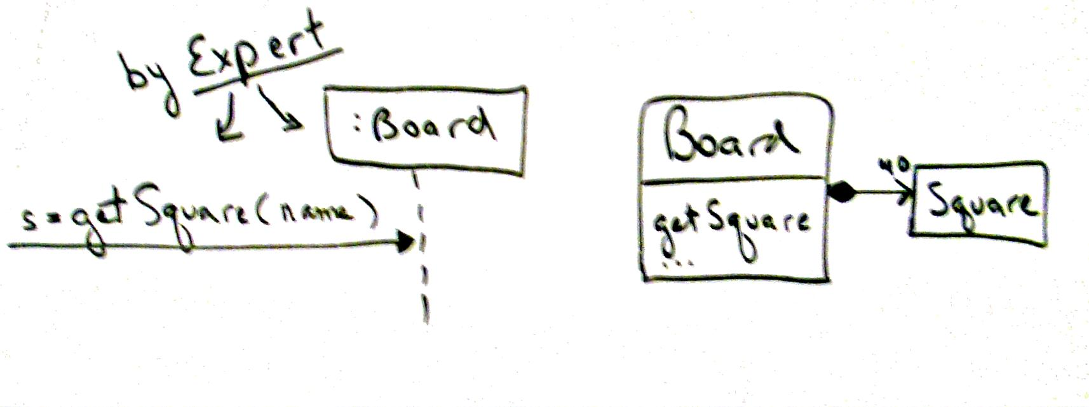

Slide 18
Information Expert: Example POS
In the Nextgen POS, some class needs to know the grand total of a sale
Who is responsible for the total amount of the sale?
Using the Expert pattern, the question is: Which object has the information needed to determine the total?
Do we look in the Design Model or the Domain Model?
Depends – check Design Model if there is enough work done and relevant classes exist, otherwise go to Domain Model
For POS, we only have Domain Model (just starting Design)
What information do we need to compute the grand total?
SalesLineItems instances and their subtotals. Sale object contains these, so it is a good candidate
We then create a new object in the Design Model called Sale, add a method to handle this responsibility

Slide 20
Information Expert: Example POS (cont)
This is fine, but the total amount is composed of the sum of the line item amounts. Who determines these?
How do we determine the line item total?
We need to know the quantity being purchased, and the price of the item
The SalesLineItem is the best candidate – it would have the quantity and is associated with the Product Description in the Domain Model, so it can find the price
We can now use this analysis to build interactions and new classes in the Design Model:
We have determined that we need Sale, SalesLineItem, and ProductDescription classes in the Design Model
We have also concluded that the Sale object is responsible for computing the total sale amount, the SalesLineItem object is responsible for computing the line item sub-total amount, and the ProductDescription object must make the price of the product visible
From here, we add the following to the Design Model:

Slide 22
Information Expert: How to Use
Think of the objects in your design model as workers that you manage
If you have a task to assign (a responsibility), who do you give it to?
You give it to the person that has the best knowledge to do the task
Occasionally the knowledge to do the task is spread over several objects
Interact via several messages to do the work, but there is usually one object responsible for the completion of the task

Slide 23
Low Coupling
Problem: How to support low dependency, low change impact, and increased reuse in your design?
Solution: Assign responsibilities so that coupling remains low
Coupling is a measure of how strongly one element is connected to, has knowledge of, or relies on other elements. Low coupling means less dependence on other objects
This makes sense – if a class with strong coupling is changed, it will affect many other classes, which makes for high change impact
Consider the Monopoly Game: We assigned the getSquare responsibility to the Board, because it contains the Squares. What if we assigned it to another class, like “Dog”?
Consider the following diagrams – we have increased the coupling in our design, not a good idea

Slide 24
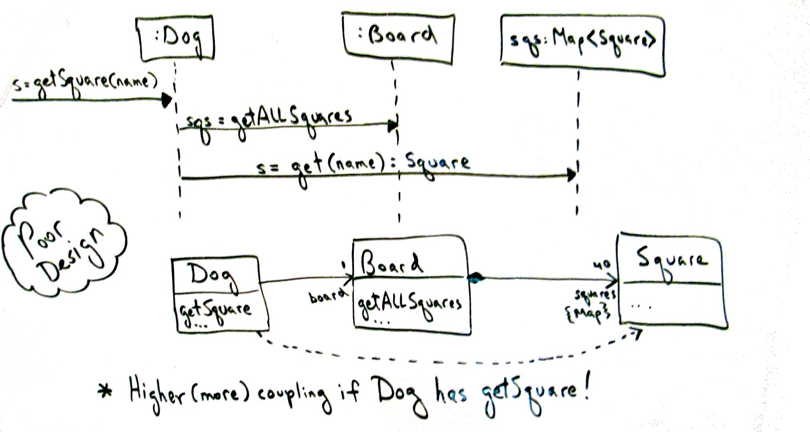

Slide 25
Low Coupling: Monopoly Example
Note this adds another layer of complexity to the design model:
First, Dog must get a list of all of the Squares from Board
Only then can it access the Square it wants to satisfy the responsibility of finding the Square instance given its name
Increased coupling – now both Dog and Board are associated with Square
Interaction diagram is a clue that this is not a good way to go …
Note that this is closely related to the Expert pattern
Usually, the Expert is the best choice to fill the responsibility, because using another object will add coupling (the alternate object choice would probably need to be associated with the expert anyway)

Slide 26
Low Coupling: POS Example
Suppose we are working on the design model for the NextGen POS, and we have defined three classes: Payment, Register, and Sale.
Suppose we have assigned the responsibility of makePayment to the Register class, and we determined that a Payment instance needs to be created and then associated with a Sale
Which class should do this, to support low coupling?
Option 1: We could assume that Register creates the Payment, and then adds the Payment to the Sale with a new method
Option 2: We could have the Register request the Sale to create the Payment
Note that Option 2 supports low coupling (see next diagram), so in terms of just low coupling Option 2 would be preferred

Slide 28
Low Coupling: Observations
Always good to reduce coupling in design decisions, but can’t be the single factor
In coding, coupling could mean:
Having an attribute that refers to an instance of another object
Calling services or methods of another object
Referring to an instance of another object in a method
Direct or indirect subclass
Using an interface
Low coupling is good – independent objects lessen impact of change

Slide 29
Takeaways from Chapter 17
We’ve seen the following GRASP patterns:
Creator
Information Expert
Low Coupling
Understand them and why they are used

Slide 30
Next …
More GRASP: General Responsibility Assignment Software Patterns
Read Chapters 17 and 25

